Slide 1



Improve the robustness of your embedded software by using the Intel Simics virtual platform and hardware fault injection
Virtual Platforms
Nov. 20, 2025
14:10-14:30
Nicolas VAN SPAANDONCK
Senior Field Application Engineer at Wind River
Réfectoire

Slide 2
Agenda
What is Intel Simics?
Available Simulation Models
Intel Simics Capabilities
Fault Injection:
  By Traffic Interception
  By Memory Operations Interception
  By Devices Error Registers
Cyber-Testing with RESim and Intel Simics
Interesting References
Simics® is a trademark of Intel Corporation or its subsidiaries.

Slide 3
Deliver better software, faster and at lower cost
Scalable full-system simulation
Runs final target binaries
Enables:
  Hardware and software co-development
  Rapid test and integration
  Ability to inject hardware faults
Increases
  System quality
  System performance
Reduces
  System integration costs
  System lifecycle costs
  System development time
Complete Systems
and Networks
Racks of Boards
and Backplanes
Complete
Boards
Devices
and Buses
SOC
Devices
Processor and Memory

Slide 4
Simulate any end-system size in a virtual network
Target Software Stack
Target Software Stack
External Tools
Applications and Software Middleware
Debugging
Testing
Scripting
GUI
Drivers and Boards Support Packages (BSP)
Model Library
Hypervisor / Target Operating System
Intel
Virtual
Network
Target Virtual Hardware
Target Virtual Hardware
External I/O
Wind River
Memory
CPU Core
CPU Core
CPU Core
...
CPU Core
Ethernet
Serial
Keyboard
Mouse
Customers
Ecosystem
Devices
Storage
Network & I/O
C, C++, SystemC, Python, DML
Intel® Simics® Simulator
Host Operating System
Host Hardware
Simics® is a trademark of Intel Corporation or its subsidiaries.

Slide 5
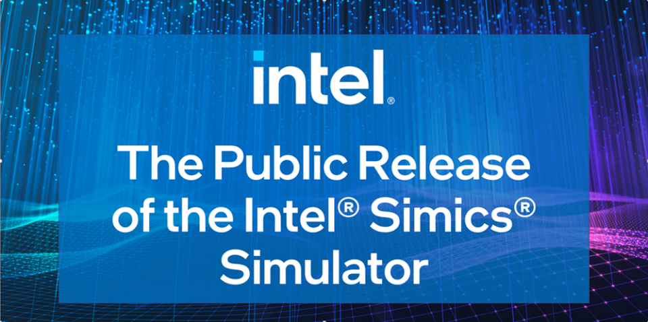
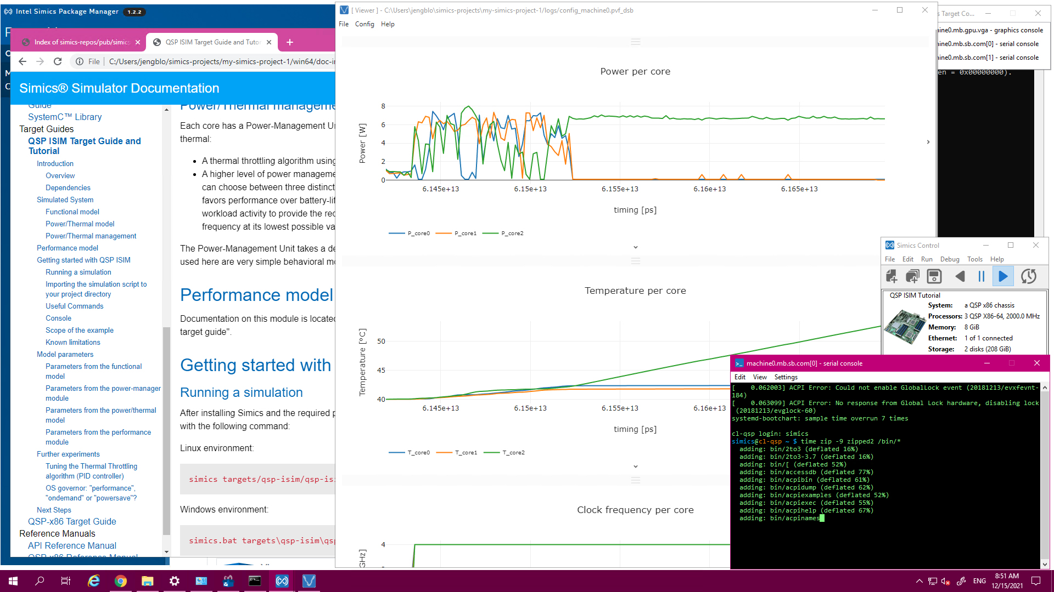
Intel simics and wind river
Simics is an Intel product, made publicly available since 2022.
Wind River used to be an Intel subsidiary between 2009 and 2018.
Wind River has an agreement to resell Intel Simics with technical support and services.
Simics® is a trademark of Intel Corporation or its subsidiaries.

Slide 6
Available simulation models
Architecture | Semiconductor | SoCs | Intel Simics 6 | Intel Simics 7
 |  |  | Wind River Edition | Wind River Edition | Intel Public Release
 |  | Recent Core and Xeon models
 |  | Agilex
 |  | Zynq US+ MPSoC
 |  | Versal
 |  | S32G
 |  | LS1
 |  | Stellar
 |  | TDA4
 |  | Several cores
 |  | PolarFire SoC
 |  | e300 to e6500
 |  | LEON3 and 4
x86
Simics® is a trademark of Intel Corporation or its subsidiaries.

Slide 7








Intel simics capabilities
Adopt new development techniques not possible with physical hardware, from the smallest to the most complex systems.
Synchronous Stop for Entire System
Reverse Execution, Unlimited Breakpoints
Determinism and Repeatability
See Everything, Trace Everything
Full-System Checkpoint and Restore
Repeatable Fault Injection on Any Component
Scripting and Automation
Real-World Connectivity
Simics® is a trademark of Intel Corporation or its subsidiaries.

Slide 8
Fault injection in Intel Simics
Fault injection is a technique used to test system robustness by deliberately introducing errors or faults.
Intel Simics allows precise fault injection control over when and where faults are injected at the following levels:
Hardware
Inject faults into memory (e.g. bit flips)
Simulate CPU register corruption
Software
Modify system calls or interrupt behavior
Simulate corrupted data structures or invalid inputs
Environment
Network latency or packet loss
Power failures issues
Emulate device failures (e.g. disk read errors, USB disconnection…)
Simics® is a trademark of Intel Corporation or its subsidiaries.

Slide 9
fault injection by traffic interception
Intel Simics allows the interception of traffic in the system, including:
Network packets.
Bus transfers.
Memory reads.
Intel Simics
Other Target HW
Applications
Target OS
Target HW
Applications
Network Interface
Communications
Device
Target OS
Memory Map
… …
Processor
Core
Device
Mapping
Communications
Device
Fault Injection
Module
(Extension)
Bus or Network Model
Device Interface
Simics® is a trademark of Intel Corporation or its subsidiaries.

Slide 10
Example: network packets injection on microchip PFSOC
Let’s load the Ethernet injector component:
> load-module eth-injector-comp
Let’s instantiate it:
> new-eth-injector-comp name = inj0
Let’s connect it to an Ethernet PHY:
> connect pfsoc.phy[0] inj0.link
Let’s inject a Wireshark PCAP log containing a previously recorded ICMP flood:
> inj0.injector.start file = flood.pcap

Slide 11
fault injection by memory operations interception
Intel Simics
Target HW
Applications
Target OS
Memory Map
… …
Processor
Core
Mapping Interception
Device or Memory
Device
Mapping
Memory
Operation
Callbacks on all memory operations
Change contents of memory operation, before or after it has been processed by its target
Fault Injection Module
(Extension)
Simics® is a trademark of Intel Corporation or its subsidiaries.

Slide 12
fault injection by Error reporting registers in devices
Intel Simics
Target HW
Applications
Error Handler Code
Target OS
Error-handling code reads error register values
Interrupt activates error-handling code
Memory Map
… …
Device Model
Processor
Core
Device
Mapping
Error Registers
Send error interrupt to processor core
Fault Injection Module
(Extension)
Set error registers to appropriate values
Simics® is a trademark of Intel Corporation or its subsidiaries.

Slide 13
Example: Injecting ECC Faults in a SPARC V8 CPU
Intel Simics provides an interface called sparc_v8_ecc_fault_injection to simulate uncorrectable ECC faults in SPARC V8 architectures.
These faults trigger exceptions like:
Instruction Access Exception
Data Access Exception
Register Access Error
SIM_INTERFACE(sparc_v8_ecc_fault_injection) {
void (*inject_instr_access_exception)(conf_object_t *cpu);
void (*inject_data_access_exception)(conf_object_t *cpu);
void (*inject_reg_access_error)(conf_object_t *cpu);
};
def inject_fault(cpu_obj):
# Set a breakpoint at a specific instruction or memory location
bp = simics.Breakpoint(address=0xdeadbeef, cpu=cpu_obj)
# Define callback to inject fault
def fault_callback():
simics.inject_data_access_exception(cpu_obj)
print("ECC fault injected at 0xdeadbeef")
# Attach callback
bp.set_callback(fault_callback)
Simics® is a trademark of Intel Corporation or its subsidiaries.

Slide 14

cyber-testing with resim and intel simics
RESim goals:
  Identify and analyze software that executes on embedded systems.
  Reverse-engineer protocols used by services on those systems.
  Discover and analyze potential vulnerabilities, e.g. via fuzzing.
  Unknown systems (black box) and systems we should know.
RESim features:
  System execution tracing:
    System call tracing with de-referenced parameters.
    Identifies processes, network connections, IPC, etc.
  Dynamic analysis of processes:
    IDA Pro & Ghidra plugins to control execution, e.g. breakpoints.
    Ability to run forwards or backwards to system events.
    Track ingested data through memory transactions and IPC.
    Reverse-track sources of memory or registers.
  AFL Fuzzer integrated with RESim for vulnerability analysis:
    Inject data directly into application or kernel memory.
    Run target to the desired starting state rather than building test harnesses.
https://github.com/mfthomps/RESim
Simics® is a trademark of Intel Corporation or its subsidiaries.

Slide 15
Interesting References
Public release of the Intel Simics simulator and Get Started Guide
RESim: Reverse engineering using a full system simulator
RESim: Introduction Video
Device Modeling Language
Introducing RISC-V in the Intel Simics Simulator
Simics Simulator Threading with RISC-V Simple
Intel Simics Modeling Extension for Visual Studio Code
Simics Fault Injection Demonstration Video
Simics® is a trademark of Intel Corporation or its subsidiaries.

Slide 16
Thank you!
Any questions? Please send them to nicolas.vanspaandonck@windriver.com

