Slide 1
20th November 2025
Onysis : European secure SoC FPGA

Slide 2


Who am I ?
Adrien GRASSEIN
Technical expert (RTL/ESW) @ NanoXplore
Prototyping / Emulation referent @ NanoXplore
Strong background in embedded software:
Baremetal
Linux Kernel
Android OS
Creator of the prototyping activity @ NanoXplore
RTL architect

Slide 3




Who are we?
NanoXplore
French based company: Paris / Grenoble / Montpellier
140+ Employees with more than 90% R&D Engineers
​
Offer products for Hi-Rel markets​
3 different products offering :​
High reliable SoC FPGA​
ASIC design services​
Silicon Ips
ITAR Free Technology​
Focus on Space & Defense markets​

Slide 4

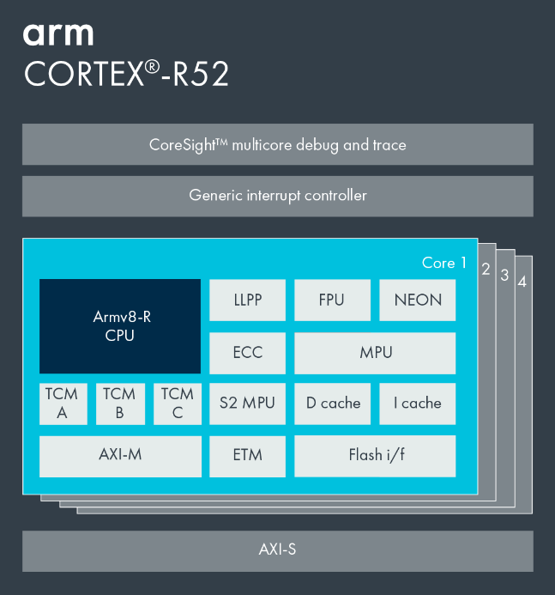

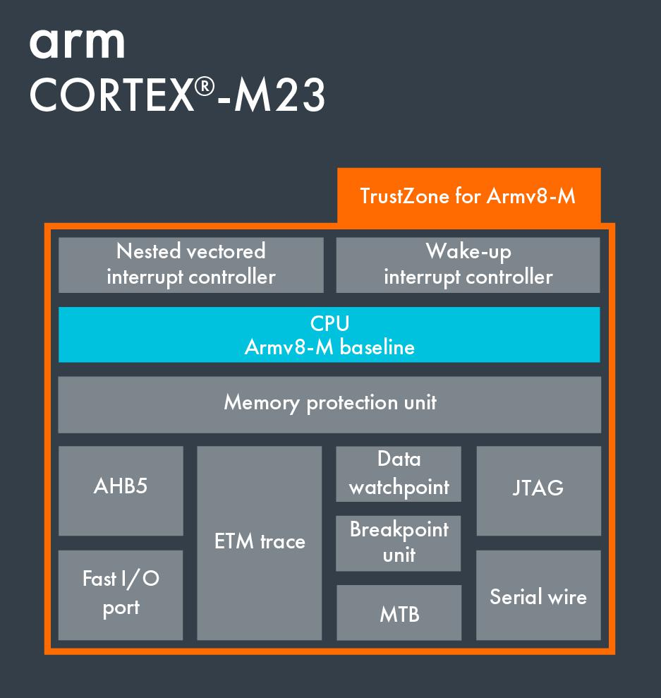
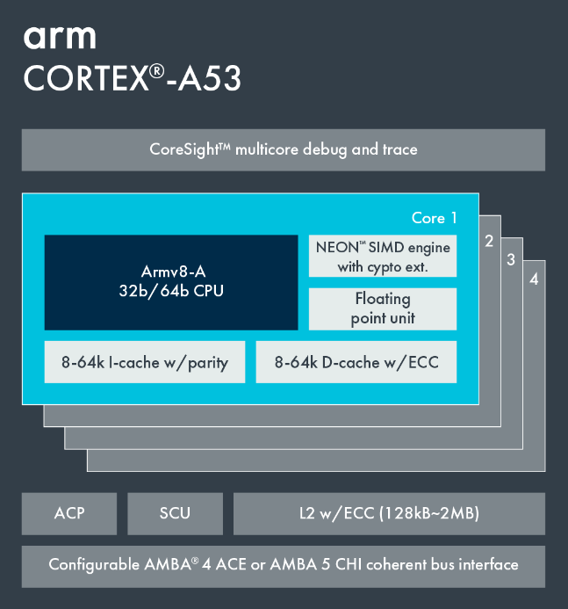
General presentation
Onysis: What is it?
Key differentiator
Package: BGA784
FPGA : 147K LUT4
Secure Unit (Secure boot, Cryptographic services)
Platform Management Unit (Cortex M23)
Application Processing Unit (2x Cortex A53)
Real-time Processing Unit (2x Cortex R52)
12Gbps HSSL
System functions:
DMAs
CoreSight Debug & Trace
Secure & User OTP
Memories:
OCR, TCM, DDR3/4, QSPI NOR Flash, eMMC
A set of standard peripherals:
PCIe, Eth, SpaceWire, SPI, UART, I2C, GPIO
Security target:
EAL 4+, AVA_VAN 5
Designed for Defense market
New FPGA
architecture v4
New FPGA software​
Up to 40-50% more performance
vs. NG-ULTRA
Improved logic density
Security at state of the art vs. other commercial FPGA

Slide 5
Onysis SoC
SoC Capabilities
Dual Cortex A53 (APU):
Run rich OS as Linux;
Dual Cortex R52 (RPU):
Hard Real Time tasks;
Cortex M23 (PMU):
Platform Management;
Low power core
SoC Defender (SD):
Cryptography;
Global security;
Secure boot
Interfaces between FPGA and SoC:
AXI (Initiator and targets)
IRQs;
Resets
Secure Boot:
Boot files are encrypted and authenticated;
Anti copy on some interfaces (a specific boot media (ie: a flash) is linked to a specific chip)
HW Container isolation:
Define a set of HW resources to isolate from the rest of the SoC;
Creation of “mini SoC” inside the SoC
External interface lock-down:
Can disable any external interface (boot / debug) of the SoC

Slide 6
Focus on security
HW Container isolation
An important security feature to physically separate different function on a system;
Example:
- A network interface should not have access directly to a memory area containing unencrypted data;
- But the crypto processor should;
- And the cyphered data may be sent to the network.
How to ensure this separation on a SoC FPGA?
Bonus question: How can users access this feature easily and intuitively

Slide 7
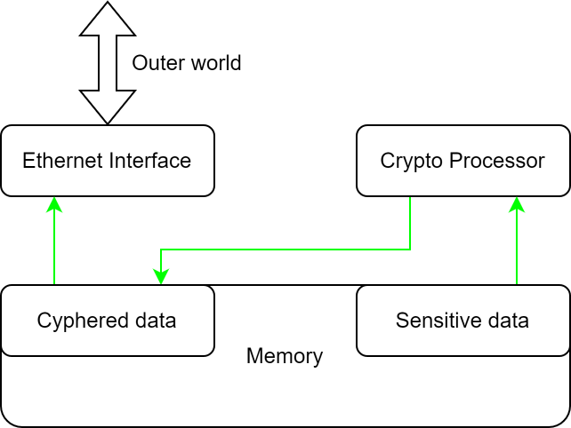
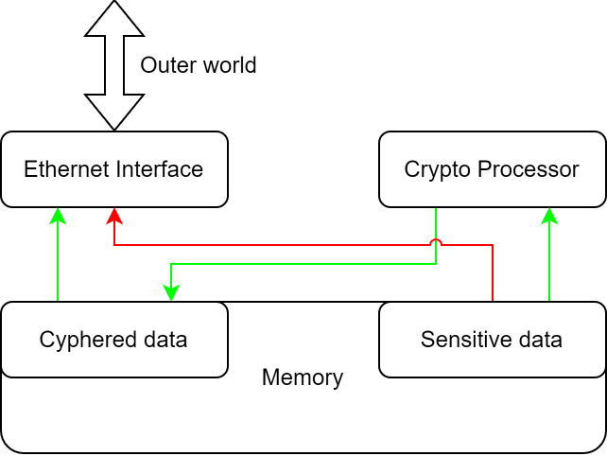
Focus on security
HW Container isolation
Expected behavior
Possible behavior
without protection

Slide 8
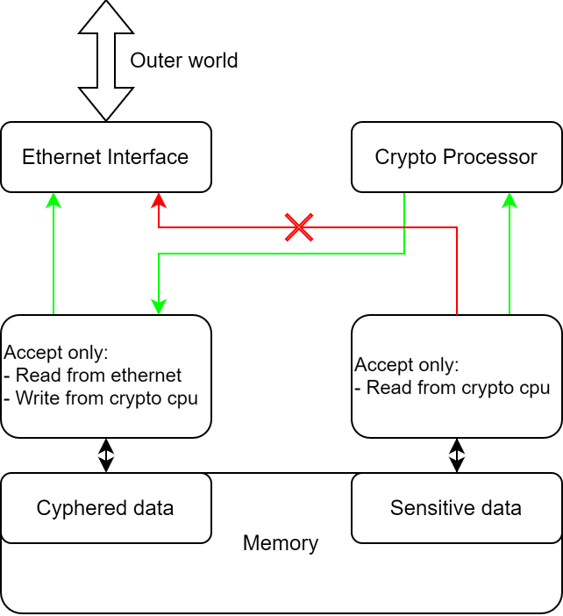
Focus on security
HW Container isolation
Introducing HW container to avoid this:
Regroup initiators and targets on a “who needs to work together” basis;
Configure some "RTL dedicated block" (xPU) to accept or deny any access to targets based on rules (read/write for example);
Introducing xPU (Protection Units):
IPU: to filter IRQs;
MPU: to protect memories:
PPU: to protect peripherals:;
Other xPU to perform specific checks

Slide 9
Focus on security
HW Container isolation
xPU blocks are integrated within the SoC FPGA to form “mini SoC” (containers) inside it;
The blocks can filter on:
- Request type: Read or Write;
- Access type: Privileged / Normal / Data / Code / etc;
- Targeted address: Can apply filter just on a part of a target;
Targets could be shared;
Configuration is done at boot time by the Secure Unit and locked at runtime;
Configuration is checked permanently to prevent attack and unauthorized access;
Possible to create a Secure and an Unsecure world from the ARM TZ© point of view;
Interrupts are also filtered;
Extensible to the Initiators and targets located in the FPGA;

Slide 10
Focus on security
Secure boot and binary injection
Onysis boot interfaces:
2xSPI NOR Flash;
1x eMMC/SDCard;
The boot of Onysis is secured;
Each boot file is encrypted and signed with a keypair:
The common boot file with the product owner keypair;
Each container as its own keypair for its own software.
The SD is in charge to;
Authenticate the data;
Decrypt them;
Copy them to the right location (OCR, TCM, DDR, etc);
Containers are put in reset during the whole boot
Injection: writing the binaries onto the boot media
Two variant of the binary injection on Onysis:
Injecting on “private” media:
One of the two flash interfaces
Injecting on “public” media:
The other Flash IF and the eMMC/SD.
On private media, the SD will re encrypt all the binaries with a key drawn at the very first boot of the component

Slide 11
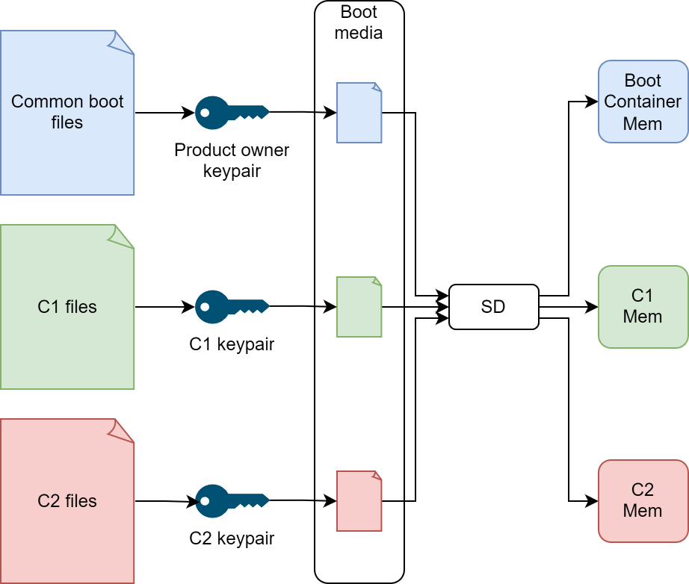
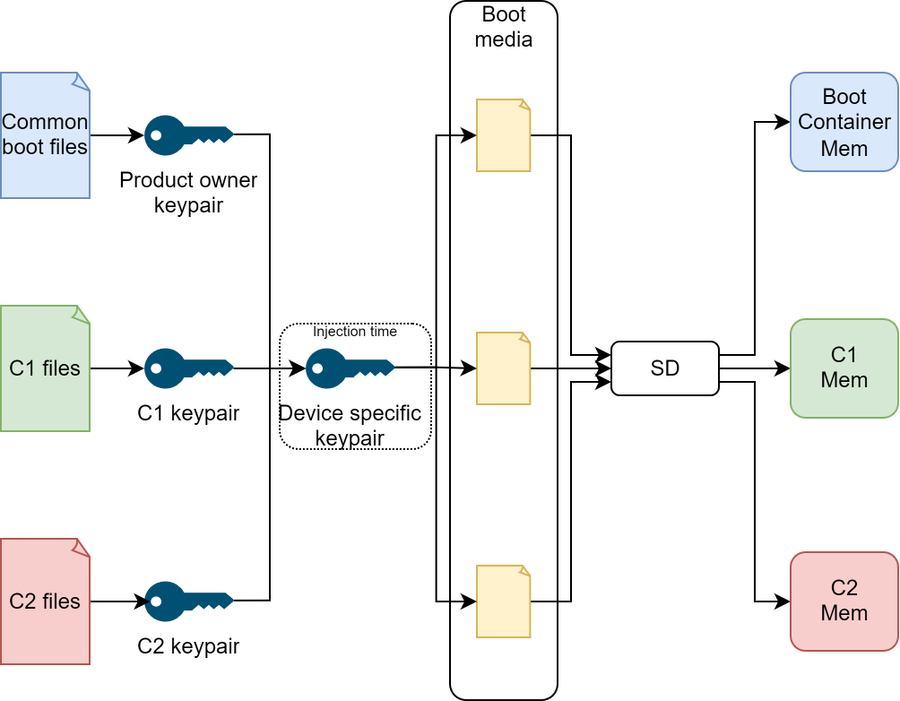
Focus on security
Secure boot and binary injection
Simple injection and boot:
Each SW is encrypted with a specific key;
The files are stored as is in the boot media
The SD decrypt them before placing them in memory
Anti-copy injection and boot:
Each SW is encrypted with a specific key;
The files are re encrypted at injection time;
The SD decrypt them before placing them in memory

Slide 12
Focus on security
Cryptography capabilities
The SD proposes some services to other Initiator through mailboxes:
Cryptography:
Key generation / derivation / exchange
Hash calculation
MAC calculation
Signature
Random generation
DRNG / TRNG

Slide 13
Fault tolerance
Fault tolerance of the SoC FPGA
NanoXplore’s FPGA is hardened against radiation:
Radiation hardened - Fault tolerant by design;
CMIC functionality to check the configuration of the FPGA at any time.
On the SoC side:
Internal memories uses ECC;
ECC on DDR;
Important signals are triplicated;
Cortex R52 can be used in Lock-Step mode;
Techno: ST 28FDSOI

Slide 14
THANK YOU

