Slide 1
November 19th 2025
Non-Volatile Memories issues in space radiative environment

Slide 2


BITFLIP
Impact des fautes
19 nov. 2028
16h20-16h40
Guillaume Bourg-Cazan
Radiation test Manager at Microchip
Réfectoire
Non-Volatile Memories issues in space radiative environment

Slide 3

Introduction
Aging
Single Event Effects
Write in flight
Possible Mitigations
Conclusion

Slide 4
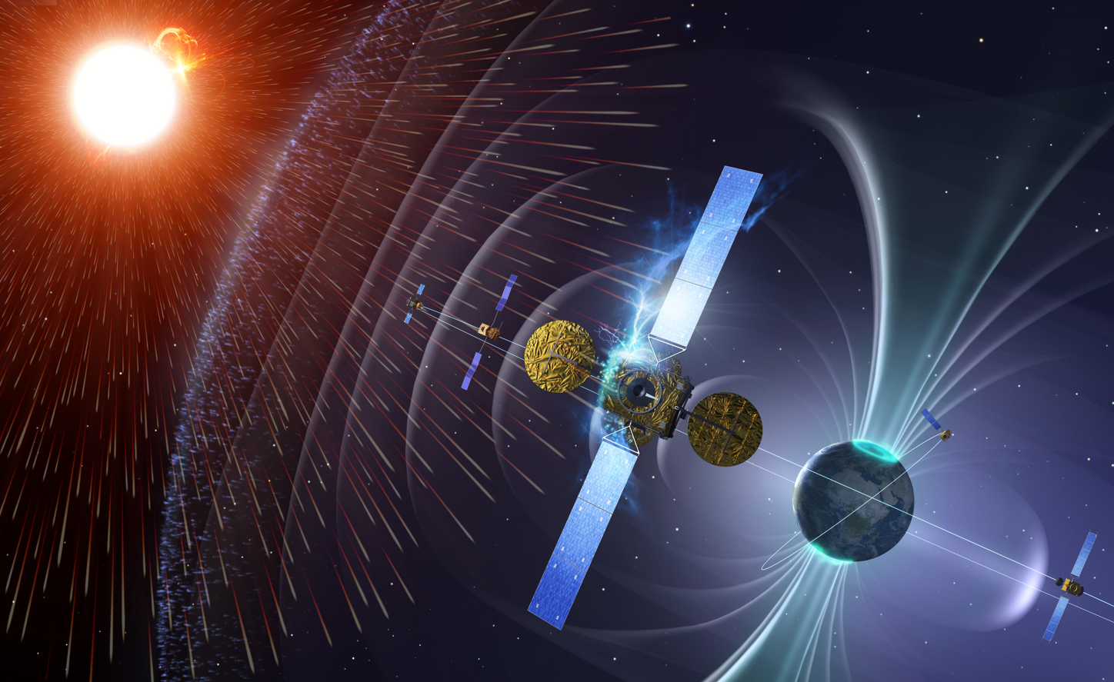
Types of failures
Aging
  TID (Total Ionizing Dose)
Single Event Effects
  Memory corruption
  Single bit flip
  Write in flight

Slide 5
Aging

Slide 6
TID -Total Ionizing Dose
Reminder of the observed effects
Vcell
Dose is a cumulated effect (ex: 1krad(Si)/year at ISS level)
Effect on the device throughout its lifetime
The key point is the difference between the cellule voltage (Vcell) and the reference voltage called margin
Data retention
    Vcell vs Dose
Degradation of reading references
    When the refence move, the margin between the reference and Vcell change
    If the margin is too low, the read is not reliable or fail
margin
Read reference
Dose
Vcell
Read reference
Data In
“1” or “0”
“1” or “0”
Dose
HV
Vcell
Reference
Write
Read

Slide 7
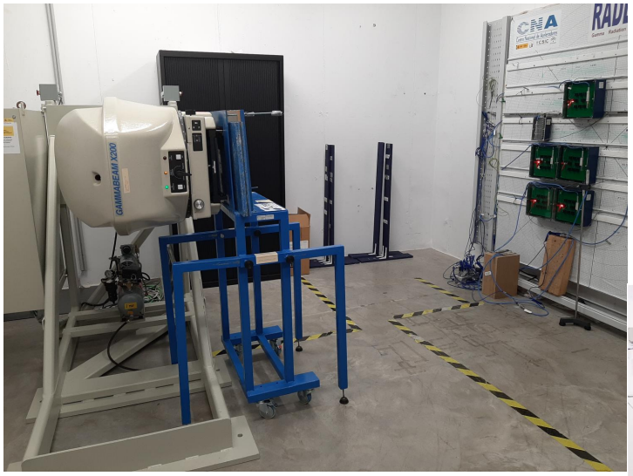
Total Ionizing Dose (TID)
Testing
Destructive test
  Prior to the irradiation, all units are programmed and measured
  Irradiation performed on Co60 source
  Dedicated board
  Static mode
Periodic readout during exposure
  Measure of critical parameters on ATE
Annealing
  Measure of critical parameters ATE

Slide 8
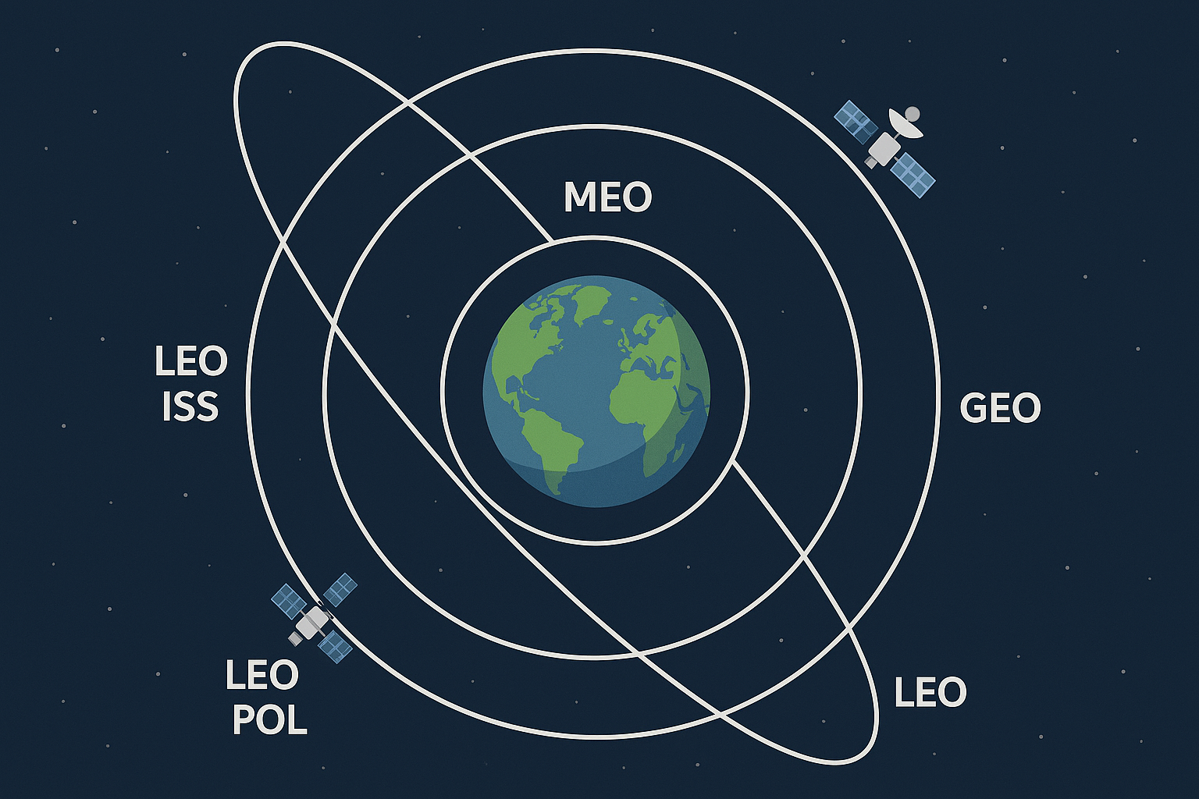
Total Ionizing Dose (TID)
Results
Microchip Device | TID in krad (Si)
SST26LF064RT | 30
SST38LF6401RT | 50
SAMV71RT | 30 (read only) 25 (write)
15 krad/y
1 krad/y
10 krad/y
5 krad/y

Slide 9
Single Event Effects

Slide 10
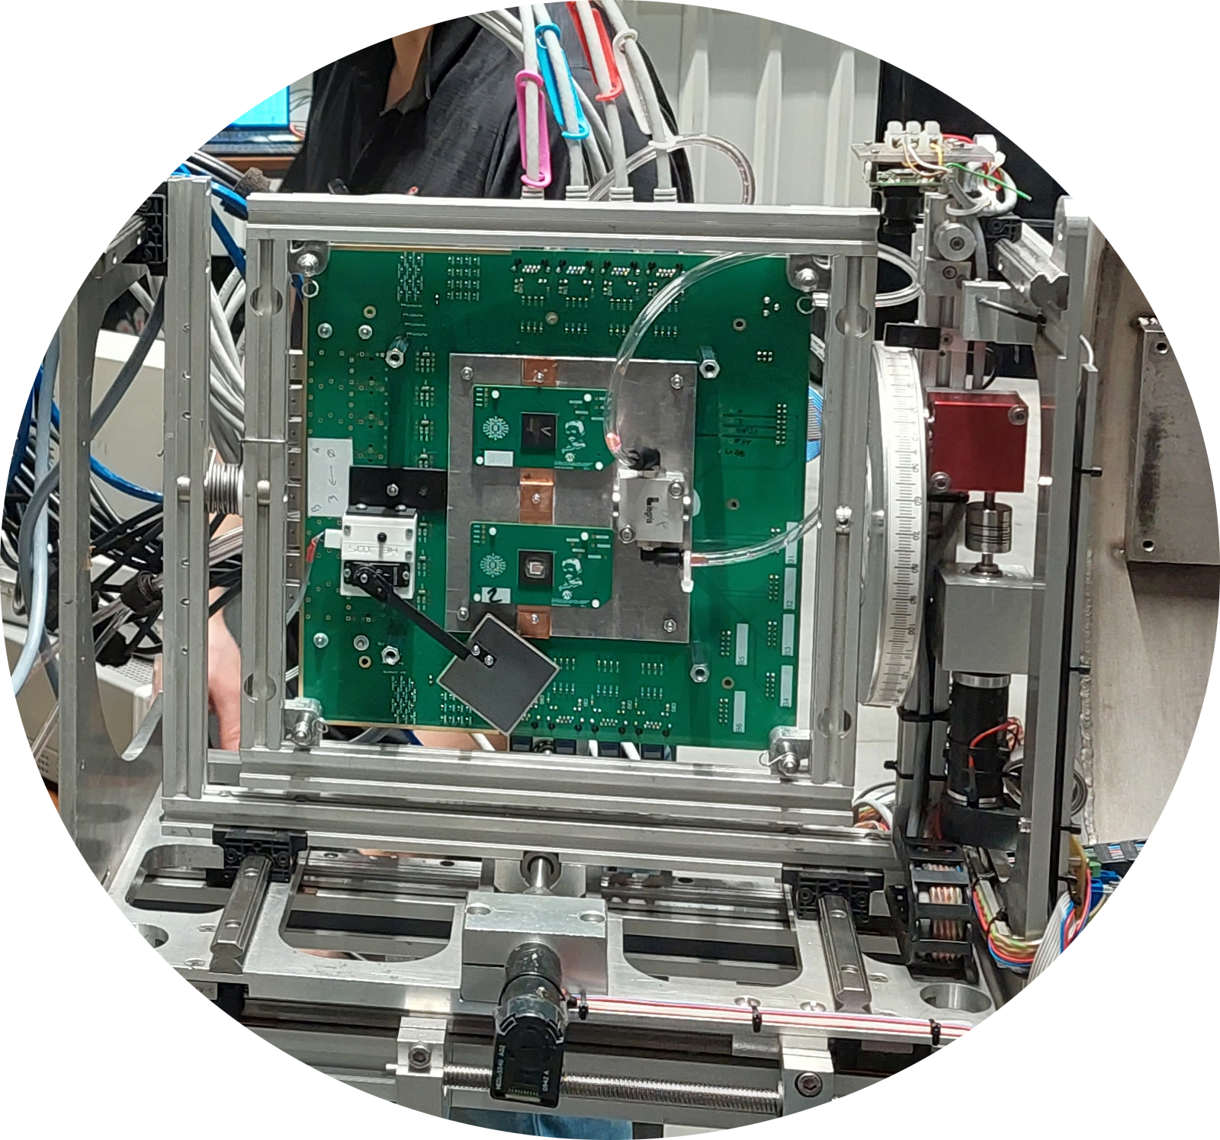
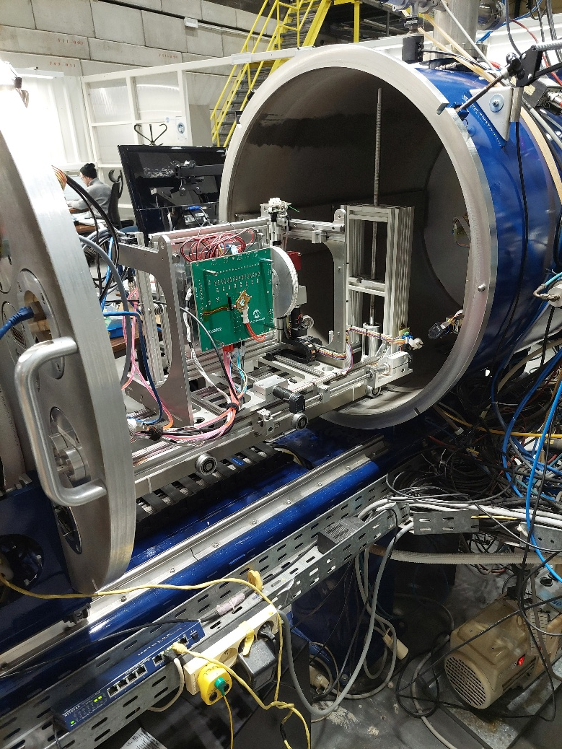
Single Effect Events
Particule
Unexpected Write
Controller
Wrapper
The embedded controller could perform write due to Heavy particles impact
Test method
  Dedicated test on particle accelerator
  Very specific test environment (tester, board, device preparation, …)
HV

Slide 11
Single Effect Events
Particle
Bit flip
Control gate
Due to heavy particle strike, charge trapped in floating gate can be affected
A single bit can flip even on an unbiased device
Test method
  Dedicated test on particle accelerator
  Very specific test environment (tester, board, device preparation, …)
+ + + + + + + + + + +
Oxide
Floating gate
Source
- - - - - - - - - - - -
Drain
p⁻ substrate
n⁺
- - - - - - - - - - - - -
n⁺
ID
After
Before
Read reference
VGS

Slide 12
Write in Flight

Slide 13
Write in Flight
TID
High voltage into the device to perform Erase/Programing operations
  TID reduces the charge pump capability
  TID increase the array leakage and overstress programing circuitry
Consequences
  Bad Erase and/or Programming : The device in no more usable
  Data retention issue
Vcell
The charge pump becomes too weak
ref
Dose
Data In
“1” or “0”
“1” or “0”
HV
Vcell
Reference
Write
Read

Slide 14
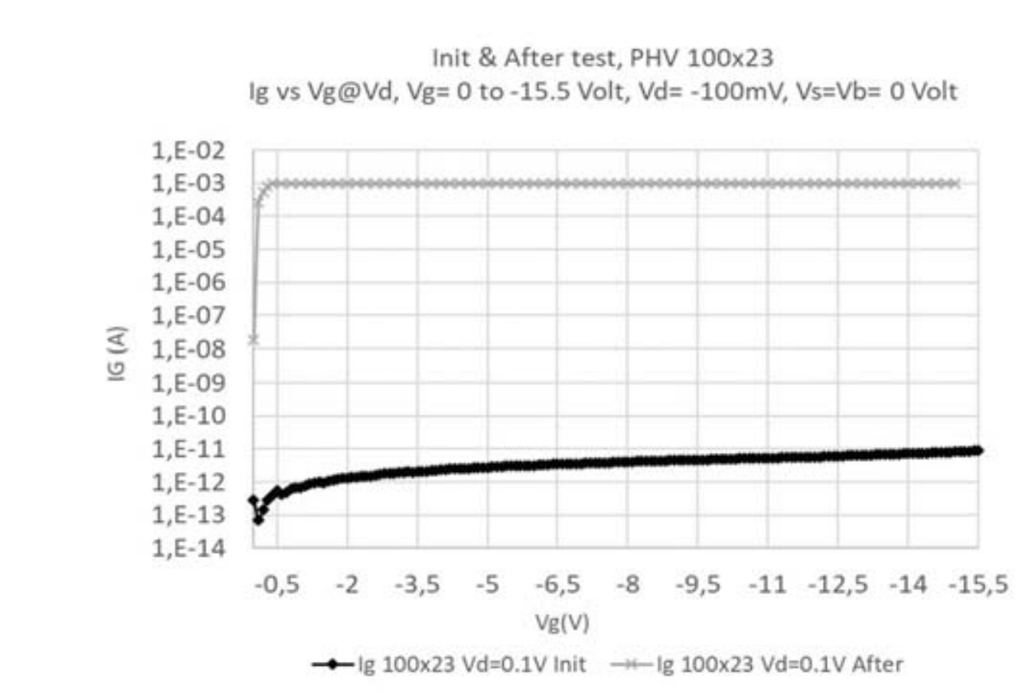
Write in Flight
Destructive effect
Particle
High voltage into the device to perform Erase/Programing operations
  If a heavy ion strike the device in a high voltage regions this can lead to a SEGR (Single Event Gate Rupture)
Test method
  Dedicated test on particle accelerator
  Very specific test environment (tester, board, device preparation, …)
Control gate
+ + + + + + + + + + +
Oxide
Floating gate
Source
- - - - - - - - - - - -
Drain
p⁻ substrate
n⁺
- - - - - - - - - - - - -
n⁺
Gate rupture
- - - - - - - - - - - - -
Ref. NSREC paper
D. Truyen et al, "Single Event Dielectric Rupture Characterization of Microchip High Voltage Devices," 2019 IEEE Radiation Effects Data Workshop, San Antonio, TX, USA, 2019, pp. 1-8, doi: 10.1109/REDW.2019.8906623.
After Irrad.
Before Irrad.
VDS = 0.1V; Krypton 1259 MeV

Slide 15
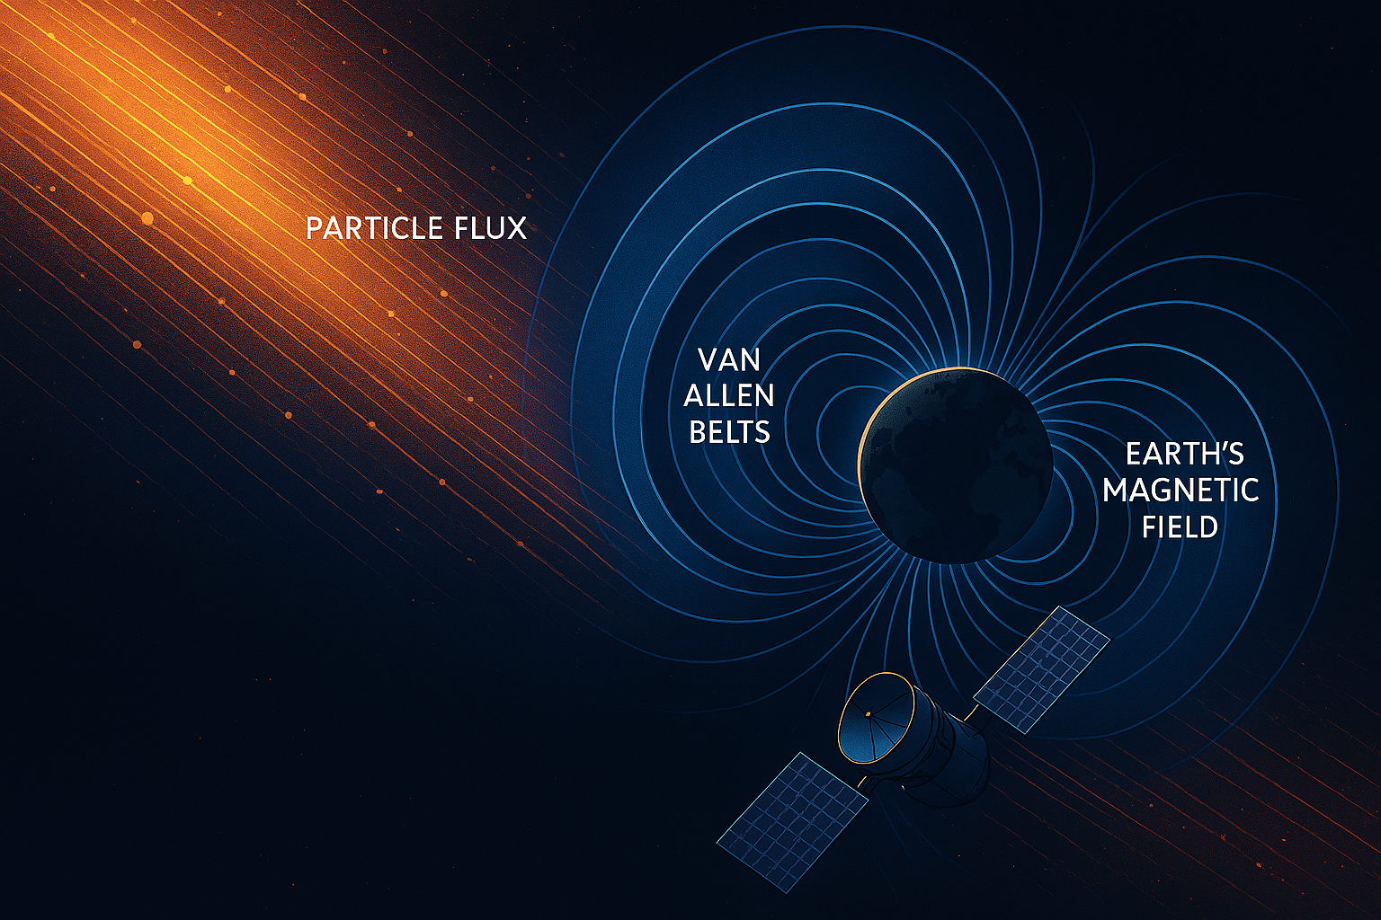
Single Effect Events
Results
Microchip Devices | Bit flip MTBF (ISS LEO)
SST26LF064RT | 2.28E10 days 62E6 years
SST38LF6401RT | 13.4E3 days 38 years
SAMV71RT | 15E6 days 41E3 years
SAMRH71* | None
* : RHBD device (Radiation Hardened by Design)

Slide 16
Possible Mitigations

Slide 17
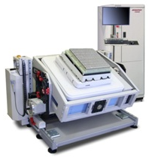
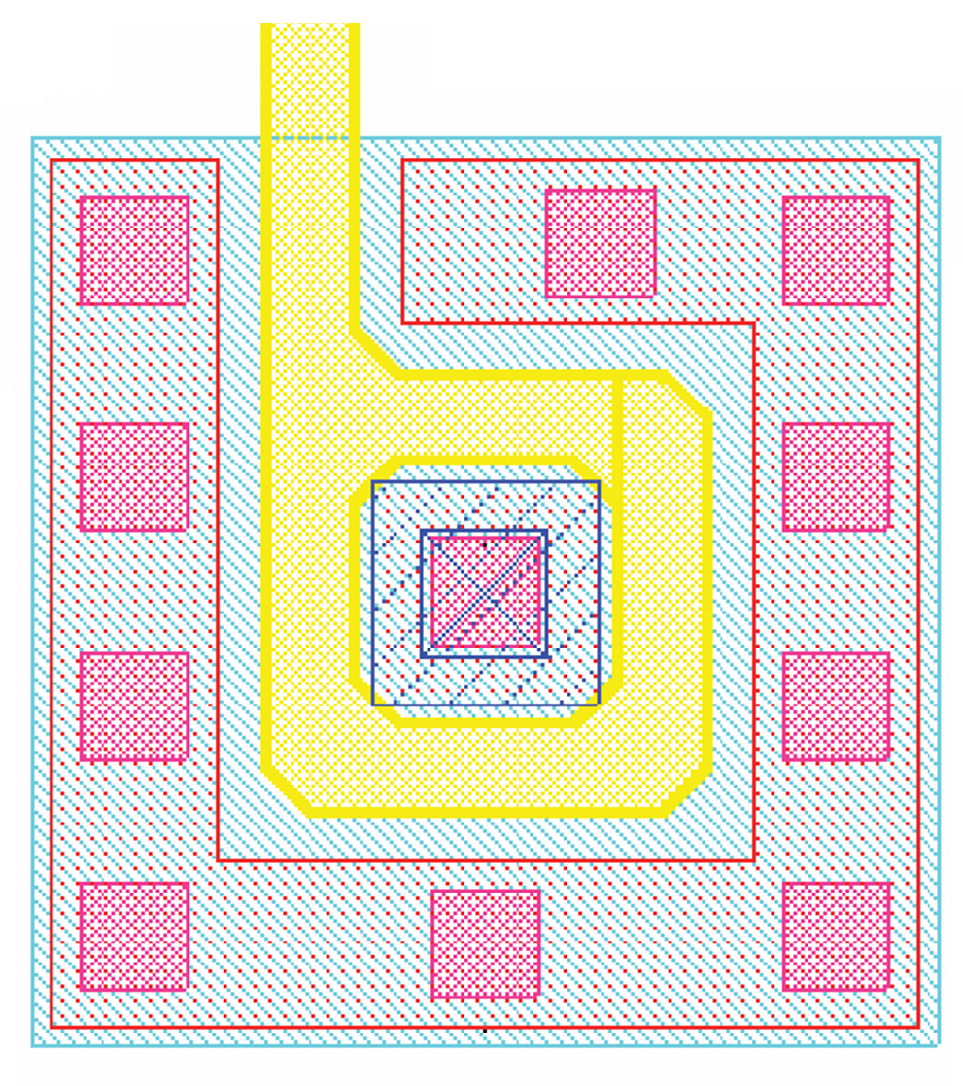
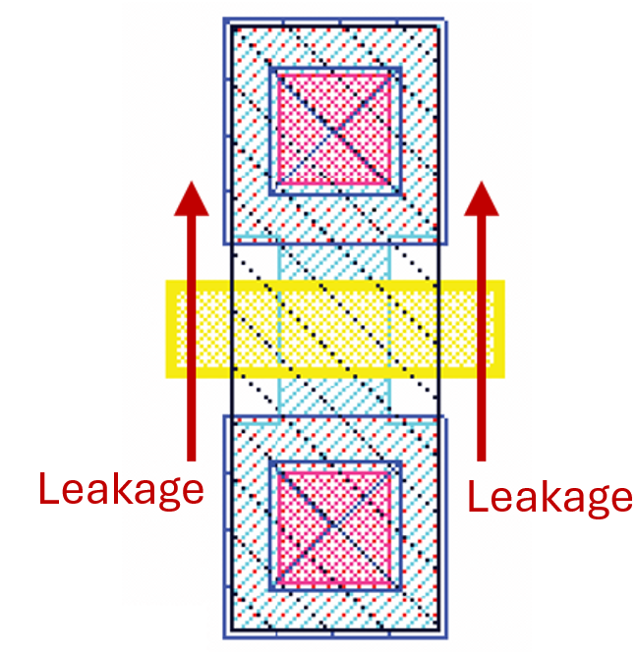
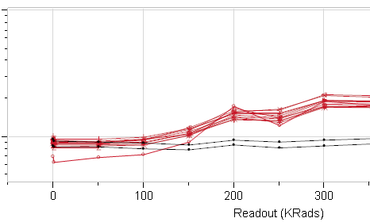
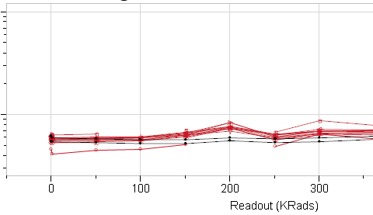
Mitigations
TID
Process
  Reduce oxide thickness
  Adding Implants to modify the parasitic transistor parameters
Design
  Choose the best technology node
  Use proven blocs
  Oversize charge pump
  Enclosed Layout transistor
Mass production (Yield impact)
  Configure the device in the better manner
    Vref configuration to anticipate drift
    Properly use spare mechanism
  Unit screening
    reject worst devices ( Margin )
Application
  Re-program the device periodically
  Shielding
Radiation induced degradation in STI oxides
Enclosed Layout Transistor (ELT)
G
Mitigation
D
S
Drain-source leakage path in NMOS
Oxides (STI)
No radiation-induced conducting path between source and drain
Poly. Gate
+++++
+++++
Linear transistor
Enclosed Layout transistor
Ioff
Ioff
Pwell / Sub
Enhancement of the leakage
Oxide-trapped charge charge build up in STI

Slide 18
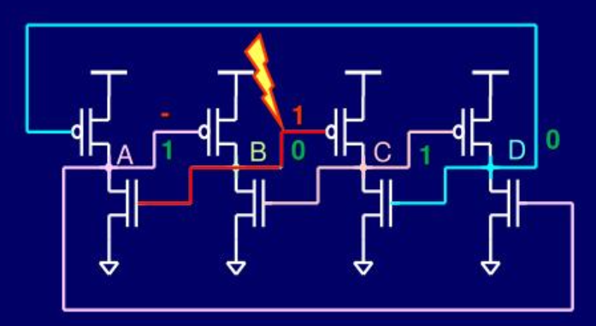
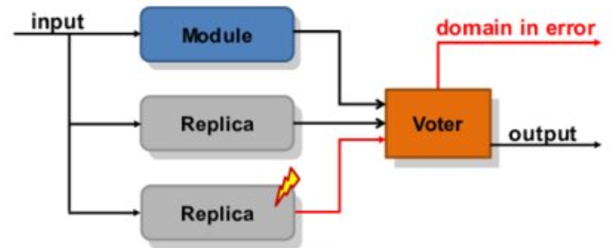
Mitigations
Single Effects
DICE: Dual-Interlocked Cell memory Pass-gates are not shown
Design
  ECC (Error Correction Code) improves the single bit flip reluctance
  Redundancy control logic
    Dice (Dual Interlocked Cell)
    TMR (Triple Modular Redundancy)
Application
  Lock the device to prevent unexpected write operations
  Duplicate the code in several regions of the memory and perform a sanity check periodically
Intrinsically immune to single node particle hit
TMR: Triple Modular Redundancy

Slide 19
Conclusion
Non-Volatile Memories are not “simple” digital bloc
High variability depending on the technology (process)
TID affect the lifetime
SEE can affect suddenly the device (SEGR, BitFlip, SEU)
The application can improve the behavior using suitable guides lines

Slide 20
Thank you for your attention
Questions?

