Slide 1
20/11/2025
Protection contre l'impact des fautes
BITFLIP

Slide 2



Protection contre l'impact des fautes
BITFLIP
20/11/2025
11:40
PATRICE BENARD
Marketing Director
Réfectoire
Radiation tolerant electronic and anti-tamper technology for harsh environment

Slide 3
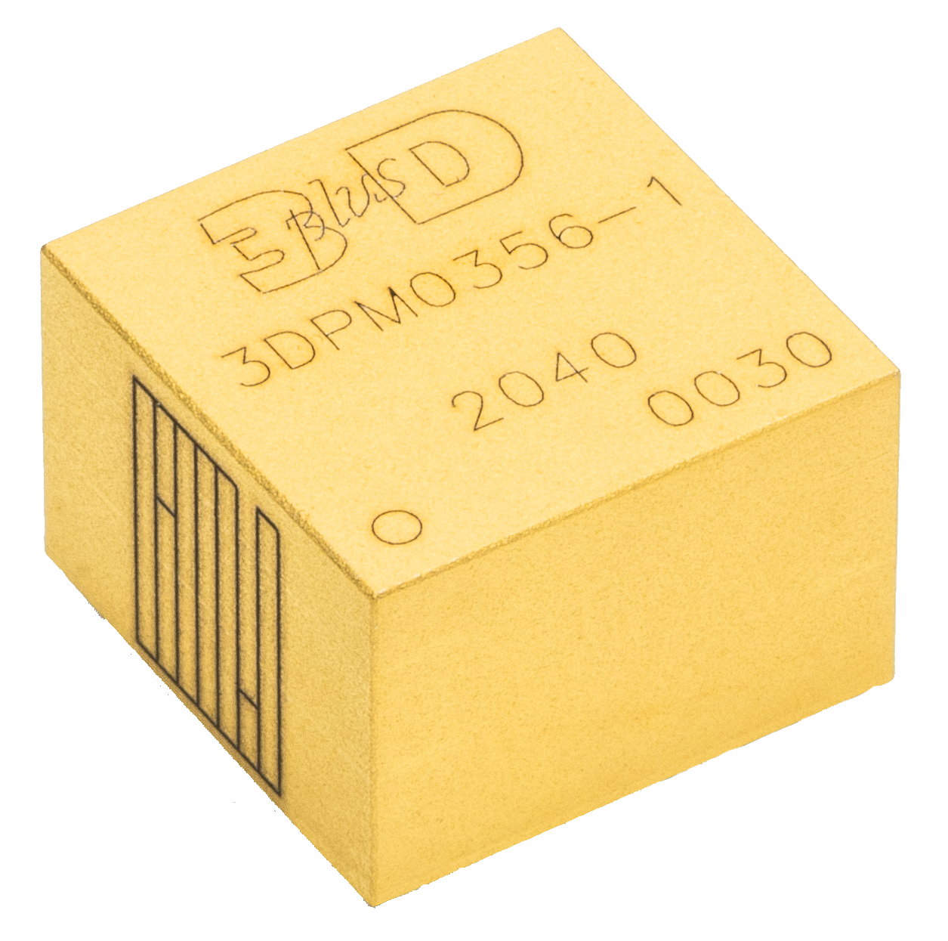
AGENDA
3D PLUS Présentation
Radiation tolerant devices
Radiation expertise
3D PLUS Technology
Custom Design
Anti-tamper technologies
Conculision

Slide 4
Key facts
CORPORATE ID
Founded in 1995
Designer and Manufacturer of electronic products and System-in-Package for high reliability and high performance applications
3D PLUS acquired Bernier Connect in 2019, Pyramid in 2021 and TRAD Tests & Radiation in 2022
People: 400 employees (consolidated)
Markets: Space, Defense, Avionics, Embedded systems, Nuclear and Industrial.
ISO-9001:2015 certified, ESA and CNES approved manufacturing line for Space Applications
More than 220 000 modules in space/orbit at the end of 2024

Slide 5
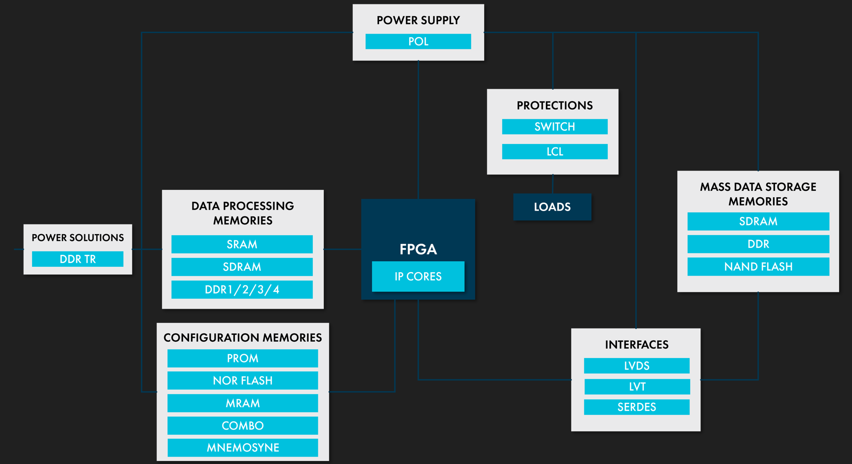
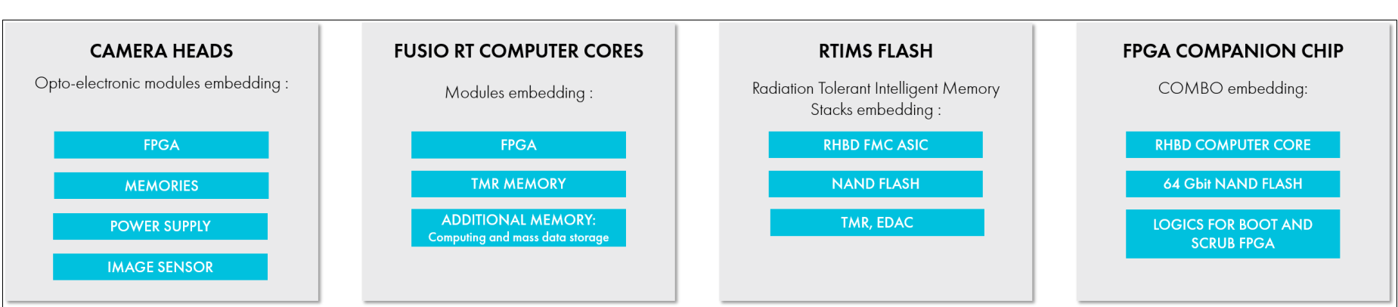
Radiation Tolerant Devices
PORTFOLIO

Slide 6
Design
Radiation Expertise
KEY PROCESS
BOM
Redesign
Manufacturing process of radiation-tolerant modules:
      Tests: Conducting SEE tests, followed by TID tests to determine the final list of components that will make up the BOM.
      Design Hardening (TMR, Switch, tantalum cover, ...)
      IP: Protection and error correction mechanisms to be implemented in the FPGAs. These mechanisms take into account the radiation performance of our components.
      Component stock: Purchasing components with the best radiation resistance. Stockpiling to cover the long-term needs of customers.
Selection of candidates (SEE)
NOK
Tests
SEE, TID
OK
Procurement of components to place in stock
Fabrication &
Qualification

Slide 7
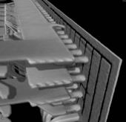
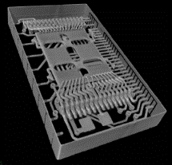
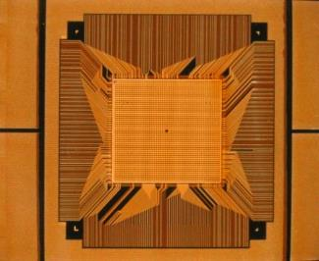
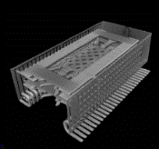
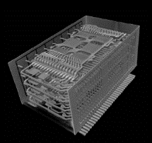
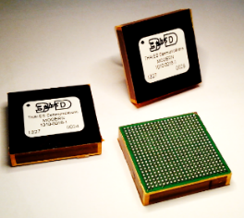
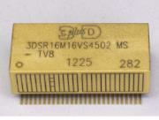
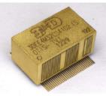
Technology
MANUFACTURING
Flow 1: TSOP
(Memory)
Flow 2: Various packages
Flow 3: WDoD
WireFree Die on Die
9

Slide 8
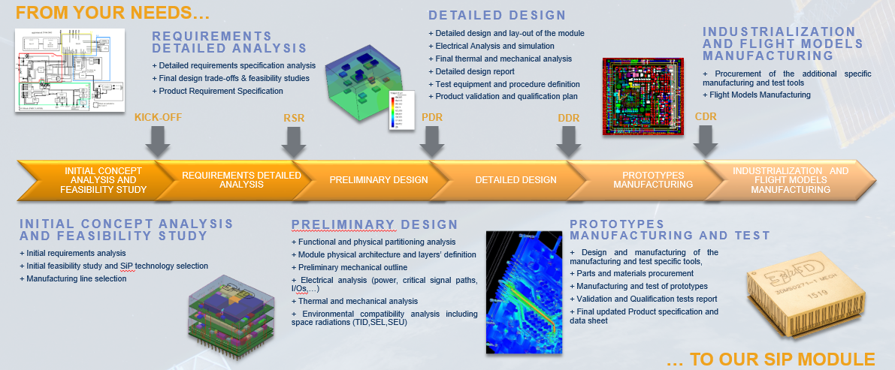
CUSTOM CONCEPT
SYSTEM-IN-PACKAGE

Slide 9
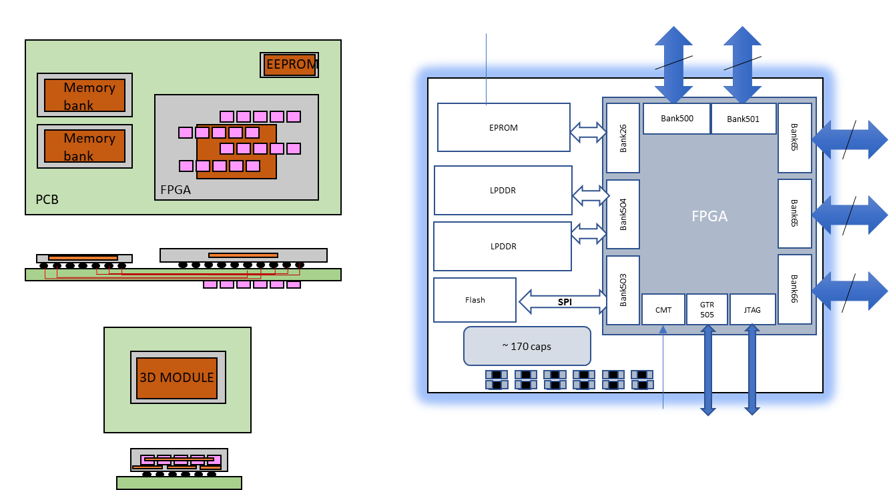
Example
SYSTEM-IN-PACKAGE

Slide 10
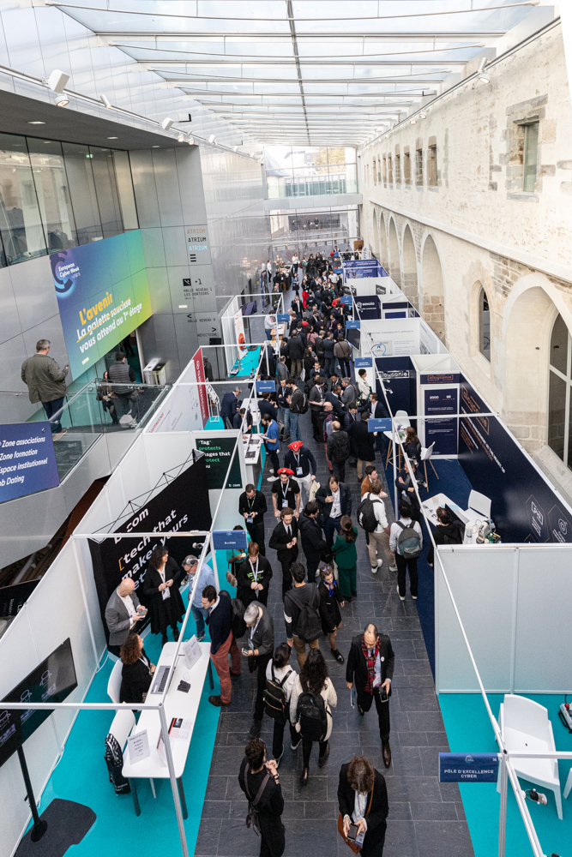

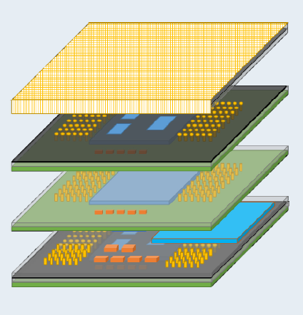
Technology
ANTI-TAMPERING

Slide 11
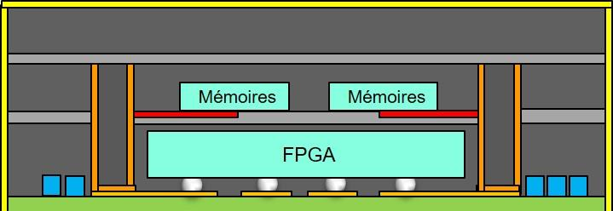

Technology
ASIC
Processor
Memory
ANTI-TAMPERING
Memory
Memory
      Critical signals hidden
      The electrical interconnects are hidden and cannot be reached from outside access.
      External or embedded Mesh
      A mesh is created all around the modules, and connected to the FPGA or processor. In case of physical intrusion, the FPGA will detect an electrical parameter modification in the mesh, and will take appropriate action (delete memory, fuse, etc.).
      Active attack detection
      Specific embedded sensors which can be activated when detecting a physical/chemical attack,
      Can be activated even without power supply
      Passive protection
      Specific molding resin with specific properties to increase opacity to X-Ray
      Additionnal fake circuitry and internal signals to complexify access to electrical schematic

Slide 12
3D PLUS
CONCLUSION
      Radiation tolerant Devices with long flight heritage
      Very large Space Qualified – Radiation Tolerant Product Porfolio,
      Space electronics and System-In-Package (SiP) design center (Analog and Digital),
      Radiation Qualification Expertise and Experience,
      Excellence in selection, qualification and reliability for the high-performance digital electronics,
      Anti-tamper Technology
      Hidden signals of SiP
      Anti-intrusion technics
      Active attack detection
      Passive Protection

Slide 13
MERCI

